Slide 1
Bookmarks
Welcome
Login
Register
© 2014 by SoftUni Foundation, No Rights Reserved

Slide 2
Bookmarks
Invalid login.
x
Login
Username:
maria
Password:
•••••••••••
Login
Register here
© 2014 by SoftUni Foundation, No Rights Reserved

Slide 3
Bookmarks
User registered successfully.
x
Registration
Username:
maria
Password:
•••••••••••
Register
Login here
© 2014 by SoftUni Foundation, No Rights Reserved

Slide 4
Bookmarks – maria
Logout
5 Great Features in EcmaScript 6 (ES6 Harmony)
x
Software University (SoftUni)
x
http://softuni.bg
http://www.wintellect.com/blogs/nstieglitz/5-great-features-in-es6-harmony
Postman - REST Client
x
http://goo.gl/daZ5Q
Visual Studio 2015 Downloads
x
http://www.visualstudio.com/downloads/download-visual-studio-vs
New Bookmark
Title:
Svetlin Nakov
Add
URL:
http://nakov.com
© 2014 by SoftUni Foundation, No Rights Reserved

Slide 5
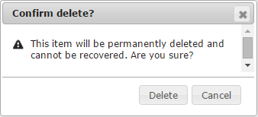
Bookmarks – maria
Logout
5 Great Features in EcmaScript 6 (ES6 Harmony)
x
Software University (SoftUni)
x
http://softuni.bg
http://www.wintellect.com/blogs/nstieglitz/5-great-features-in-es6-harmony
Postman - REST Client
x
http://goo.gl/daZ5Q
Visual Studio 2015 Downloads
x
http://www.visualstudio.com/downloads/download-visual-studio-vs
New Bookmark
Title:
Svetlin Nakov
Add
URL:
http://nakov.com
© 2014 by SoftUni Foundation, No Rights Reserved

